Slide 1
Project:
Java and Web Development
Finalization Phase
Course of Study:
Computer Science
Tutor:
Christian Remfert
Student’s Name:
Yunus Emre Dagli
Matriculation No:
102203493

Slide 2

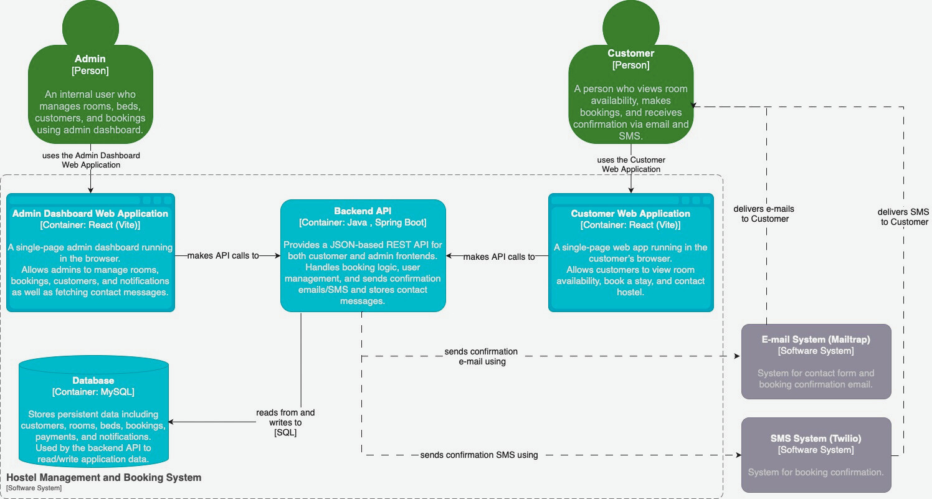
CONTAINER DIAGRAM - FEEDBACK REVISIONS

Slide 3

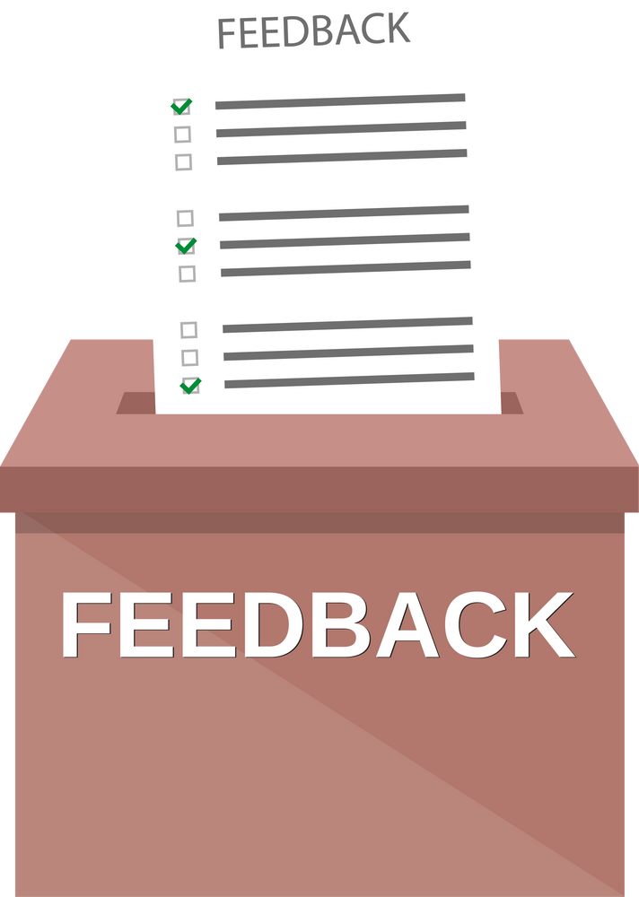
Container Diagram Fixes Based on Feedback
“Your container diagram has multiple issues: first of all, C4 model does not support backlinks, so the multiple connection between elements are not following the standard. Second, the user always connects to a frontend and not to a backend.”
First, I made sure that users only interact with the frontend. Users shouldn’t directly connect to the backend, so I updated the diagram so that both the Admin and Customer use their respective React-based Single-Page Apps. All backend interaction now clearly flows through these frontends.
I also got rid of any bidirectional or confusing arrows. In the earlier version, I had arrows that looked like the backend was somehow “talking back” to the frontend. Since the C4 model doesn’t support backlinks, I removed those and kept only one-way arrows showing the frontend making API calls to the backend.

Slide 4
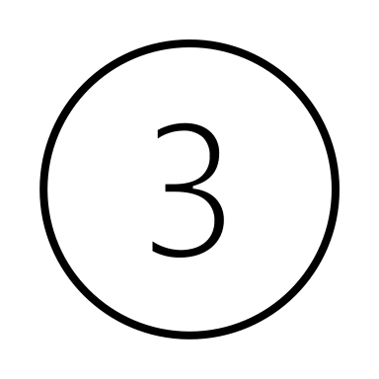
Responsive Design Fixes Based on Feedback
“Please make sure that your application is responsive. Some elements looks like they are not optimized for small screen devices.”
Problem
To begin, I audited the entire application — not just the Admin Panel, but also critical user-facing components like the HeroSection, Navbar, and the RoomShowcase. It became evident that several layout elements (particularly tables, fixed sidebars, and grid structures) lacked fluid behavior on small devices such as smartphones and tablets.
Media Queries & Screen Sizes Used
I applied responsive design principles using the following standard breakpoints:
max-width: 1024px → For tablets and smaller desktops
max-width: 768px → For tablets in portrait mode and large phones
max-width: 480px → For small mobile phones

Slide 5

Responsive Design Fixes Based on Feedback
What I Did in Practice?
Admin Panel:
Sidebar: Refactored the sidebar using position: fixed and toggled it using a hamburger (FiMenu) and close (FiX) button. The toggle state is managed via useState, and the icon updates conditionally to avoid rendering both at once.
Table Responsiveness (PaymentTable, Notification): Wrapped wide tables in a scrollable .payment-table-wrapper using overflow-x: auto, min-width, and white-space: nowrap to allow horizontal scrolling on small screens.
Grid Adjustments: Ensured .dashboard-grid and .admin-main-content margins/paddings adjust when the sidebar is open. This prevents layout shifts and content clipping.
Touch Scrolling: Used -webkit-overflow-scrolling: touch; to improve scrolling fluidity on iOS devices.
HeroSection, Navbar, and RoomShowcase:
Made key layout adjustments using media queries for images, texts, button scaling, and flex alignment.
Ensured the navbar collapses or realigns elegantly on smaller screens and doesn’t overlap other components.
Improved spacing, padding, and font scaling within the HeroSection and room cards to retain legibility and spacing.

Slide 6

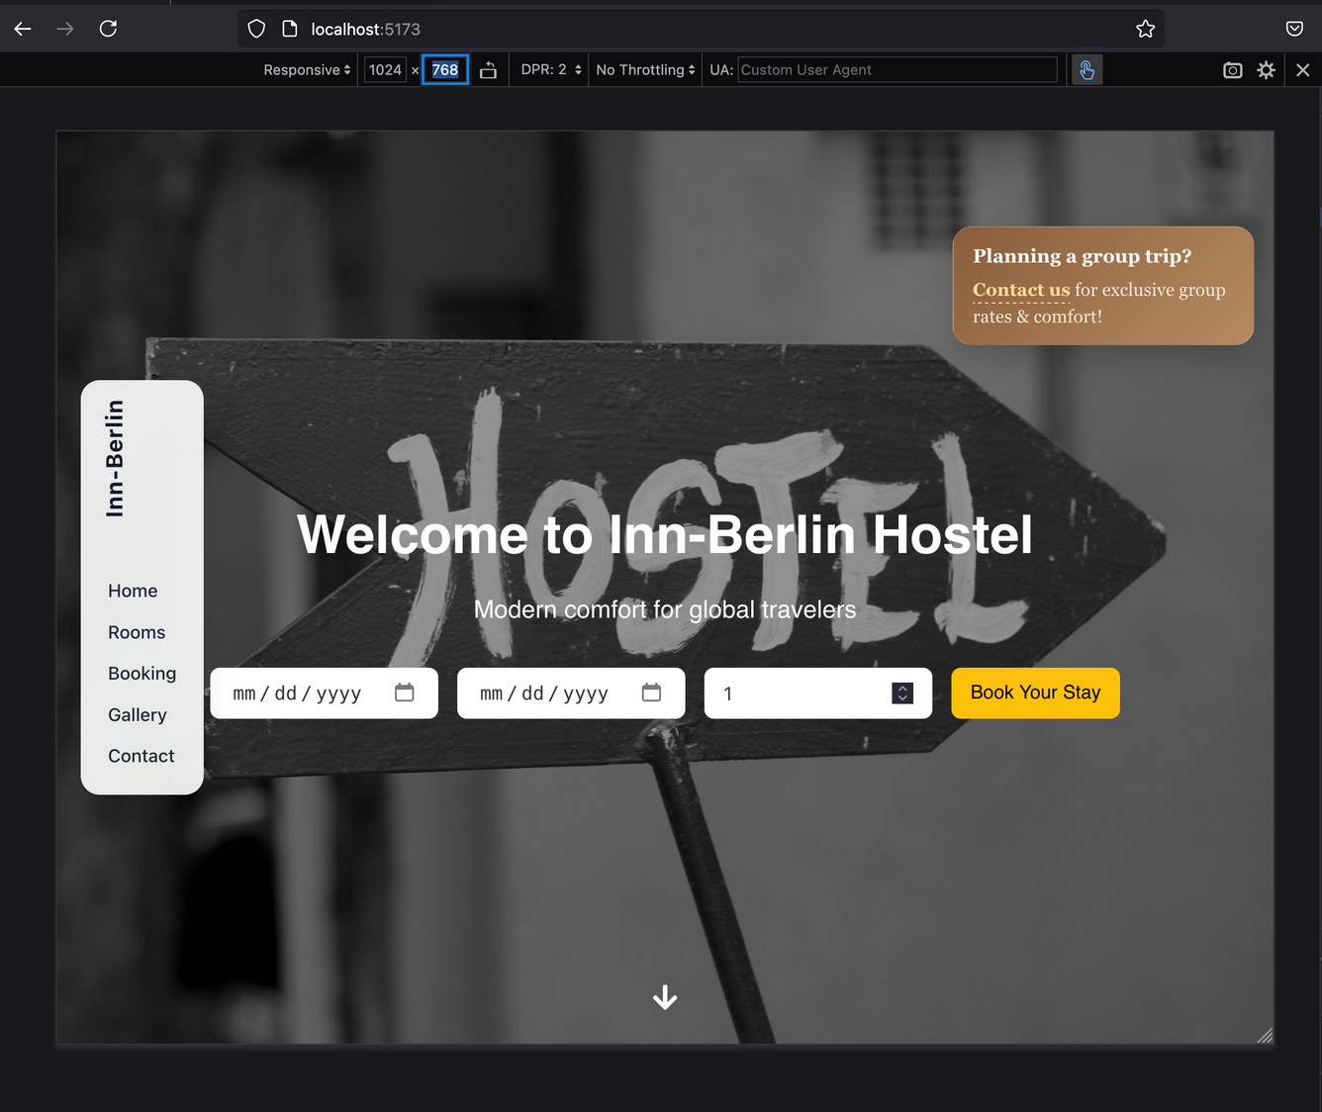
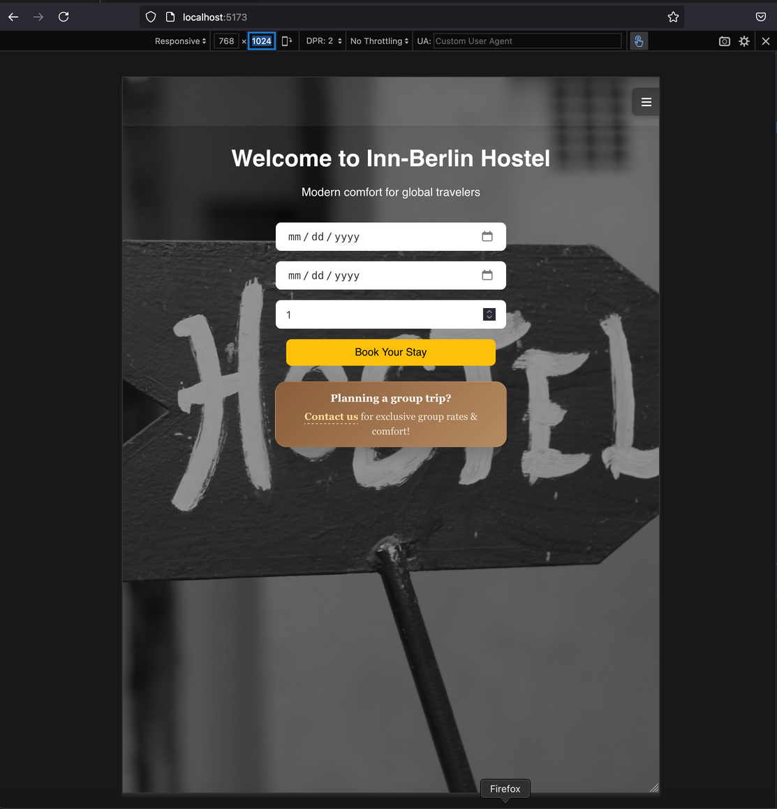
Responsive Design Fixes Based on Feedback
max-width: 1024px
1024 x 768
max-width: 768px
768 x 1024

Slide 7

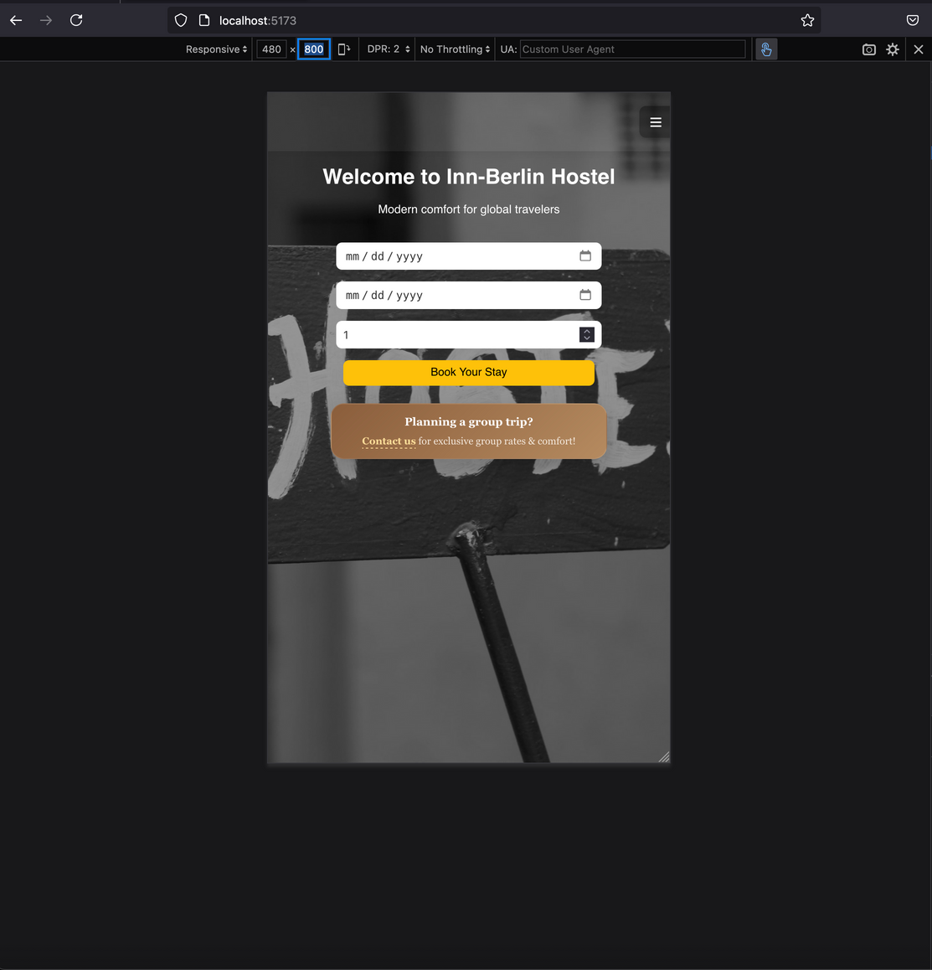
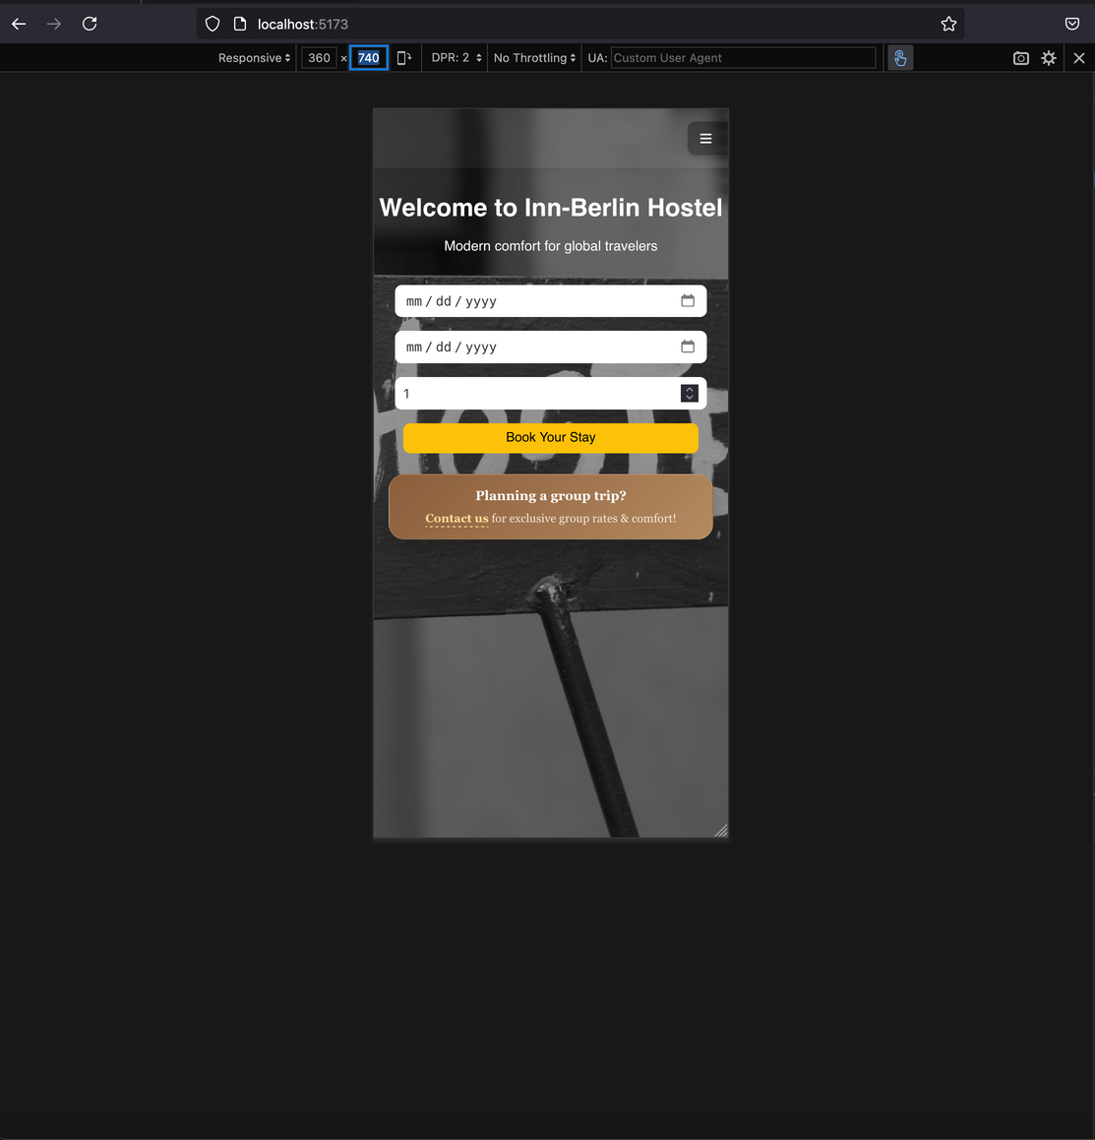
Responsive Design Fixes Based on Feedback
max-width: 480px
480 x 800
max-width: 480px
360 x 740

Slide 8

Test Cases and Expected Results
Action | Test Input / Interaction | Expected Result
Booking Form Submission | Fill out the booking form and click “Submit” | Booking is created, confirmation email and SMS are received and the summary box responses with the message “An invoice has been sent to your email address.”
Invalid Booking Attempt | “Submit” booking form with missing required fields(e.g. email) | User receives inline validation error message: “Email is required”
Admin Login | Enter valid admin credentials and click “Login” | Admin dashboard is opened with notifications table, contact messages table and management tabs
Invalid Admin Login | Use wrong credentials on admin login page and click “Log-in” | Error message shown: “Invalid username or password”
Contact Form Submission | Submit contact form with a message by clicking “Send Message” button. | If the message is sent successfully, then the response “Thanks for reaching out. We'll get back to you soon!” appears and message also appears under “Contact Messages” in admin panel
Adding a new room with the desired number of beds to the database | Click “Add Room” button, then fill the form and click “Submit” button | The response would be “Room created successfully!”

Slide 9

Test Cases and Expected Results
Action | Test Input / Interaction | Expected Result
Adding a new booking | Fill out the booking form and click “Submit” | The response with the message “Booking created successfully.”
Editing a customer information | Click “Edit” button in ”Manage Customer” tab and update the information then click “Submit” button. | The response with the message “Customer updated successfully.”
Group Booking Visibility | Click “Contact Us” in the group booking <div> on homepage. | The user is directed to the “Contact Us” form.
Mobile Responsiveness | Open the website on a mobile device (e.g. 375px width) or use a browser developer tool for different screen sizes. | All elements are responsive and properly stacked without overflow.
SMS Confirmation via Twilio | Submit a booking with Twilio-linked phone number | If the payment is successful, a confirmation box shows up with the response and the confirmation SMS will be sent to the Twilio-configured number.(In this case the number is: +4917637672512 )
Mailtrap Email Testing | Complete a booking from frontend | If the payment is successful, a confirmation box shows up with the response “Thanks for reaching out. We'll get back to you soon!” and the mail appears in Mailtrap inbox.

Slide 10

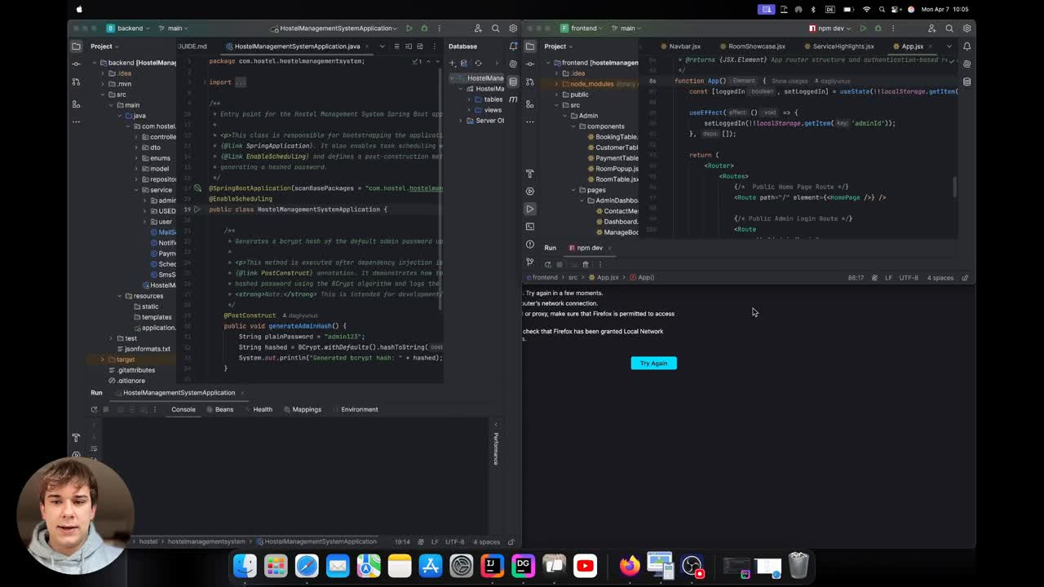
Overview Video – Current State of The Web Application

